Slide 1

Solving Non-linear equation
Newton’s method and its variations
不正经讲师：理科宅Hunt

Slide 2
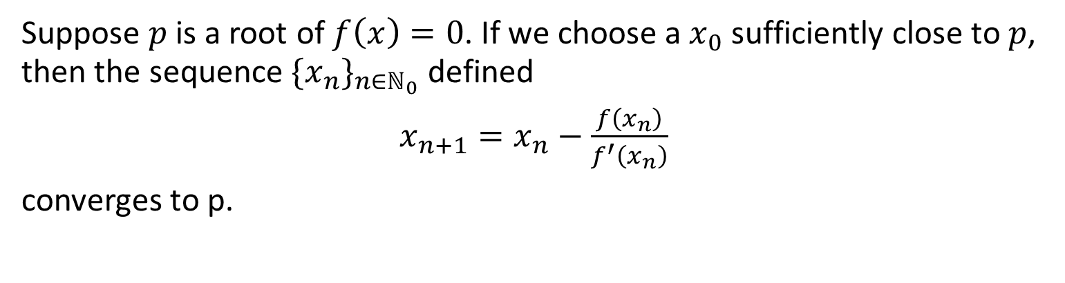
Newton’s method – 牛顿迭代法
Suppose $p$ is a root of $f\left(x\right)=0$. If we choose a $x_{0}$ sufficiently close to $p$, then the sequence $\{x_{n}\}_{n∈ℕ_{0}}$ defined
$x_{n+1}=x_{n}−\frac{f\left(x_{n}\right)}{f^{′}\left(x_{n}\right)}$
converges to p.

Slide 3

Example - 举个栗子
Calculate the approximated root of $x^{2}−2=0$ by using Newton’s iteration with $x_{0}=1$.

Slide 4

Order of Convergence – 收敛阶
Theorem: Suppose $p$ is the solution to $f\left(x\right)=0$ and $f^{′}\left(p\right)≠0$. Then, given $x_{0}$ sufficiently close to $p$, the sequence $\{x_{n}\}$ defined by Newton’s method converges quadratically to $p$.

Slide 5
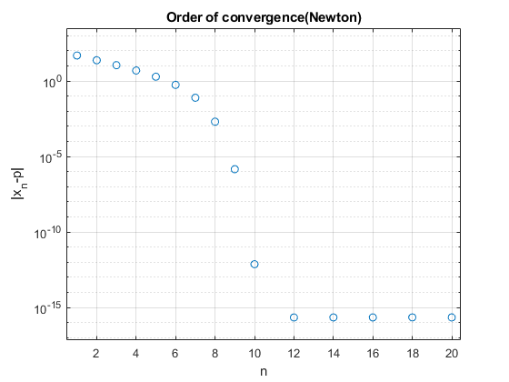

Order of Convergence – 收敛阶
直观地看，Quadratic convergence就是在semiglogy地scale下，${|x}_{n}−p|$会呈二次函数的趋势下降。
右图中的数据点是通过用牛顿迭代解
$$x^{2}−2=0（x_{0}=50）$$
得出的。
1. 一开始下降并不快，因为$x_{0}$离$\sqrt{2}$比较远.
2. 一旦靠近$\sqrt{2}$之后，就开始呈二次函数下降了。
3. 到达machine epsilon后停止下降。

Slide 6

Disadvantages of Newton – 一些不足之处
What if$f′$ is too difficult to get??
What if $f^{′}\left(p\right)=0$??

Slide 7

Secant method – 割线法
为了解决不知道$f’这个$难题而出现的（又或者说你太懒不愿意求）
Use secant to substitute $f^{′}$
$$x_{n+1}=x_{n}−\frac{f\left(x_{n}\right)}{\frac{f\left(x_{n}\right)−f\left(x_{n−1}\right)}{x_{n}−x_{n−1} }}$$

Slide 8

Example - 举个栗子
Calculate the approximated root of $x^{2}−2=0$ by using Secant method with $x_{0}=1$ and $x_{1}=2$.

Slide 9

Order of Convergence (Secant)
Theorem: Suppose $p$ is a solution to $f\left(x\right)=0$ and $f^{′}\left(p\right)≠0$. Then given $x_{0}$ and $x_{1}$ sufficiently close to $p$, the sequence $\{x_{n}\}$ defined by secant method converges to $p$. The order of convergence is $(1+\sqrt{5})/2$ (golden ratio).

Slide 10

Modified Newton – 改版Newton
为了解决$f’\left(p\right)=0$困难而出现的
$f^{′}\left(p\right)=0$并不是说Newton’s method就算不了，不过收敛得慢很多
Suppose $p$ is a root with multiplicity $m$ (that is, $f^{′}\left(p\right)=…=f^{\left(m−1\right)}\left(p\right)=0$). Then given $x_{0}$ suffiently close to $p$ the sequence $\{x_{n}\}$ defined by
$$x_{n+1}=x_{n}−m\frac{f\left(x_{n}\right)}{f′(x_{n})}$$
converges quadratically to $p$.

Slide 11
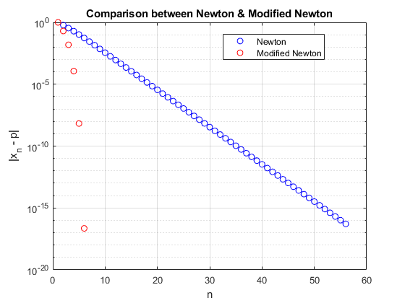

Example - 举个栗子
Compare the convergence of Newton & Modified Newton when solving $x^{2}(x−1)=0$ with $x_{0}=−1$.

Slide 12

Conclusion – 总结
Newton 固然好，但缺点有两个。都集中在$f′$上。
$f′$比较难求，就用割线近似求$f′$
$p是个$m重根，在$f/f′前$乘以m可以把收敛阶拉回2.

